Slide 1

Select your style:
CSS
Selectors
-By Nagesh Kassa

Slide 2
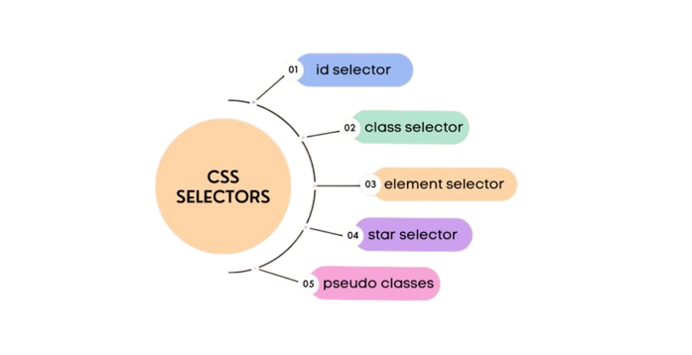
Introduction
CSS selectors allow developers to target specific HTML elements and apply styles to them.
A selector is a pattern that matches one or more elements in the HTML document.
attribute selector

Slide 3
Element Selector
Element selectors select all HTML elements of the specified type.
Syntax & Example:
P{
text-align : center;
}
It picks all <p> elements in the html document and align the text center.

Slide 4
ID Selector
An ID selector targets a single element with a specific ID attribute.
IDs must be unique within an HTML document, so an ID selector is used to select one unique element.
Note: An id name cannot start with a number!
Syntax & Example:
#para1{
text-align:center;
color:red;
}
It picks <p id=“para1"> from HTML document and it will set para1’s
color as red and align the text center .

Slide 5
Class Selector
A class selector targets all elements with a specific class attribute.
Multiple elements can use the same class and an element can have multiple classes as well.
Syntax & Example:
.boldFont {
font-weight: bold;
}
.blueFont {
color: blue; }
HTML: <span class="boldFont blueFont"> Learning CSS is fun! </span

Slide 6
Attribute Selector
An attribute selector targets elements with a specific attribute value.
Syntax & Example:
a[target] {
background-color: yellow;
}
This will style all <a> elements with a target attribute.
HTML :
Click here to open <a href="https://www.gradious.com" target="_blank">Gradious</a>
Output: Click here to open Gradious

Slide 7
Pseudo-class Selector
pseudo-class selector targets elements based on their state or position in the document.
Example, :hover selects an element when we hover over it with the mouse.
Syntax & Example:
a:hover {
background-color: orange;
}
This will style all <a> elements with a target attribute.
HTML: Click here to open <a href="https://www.gradious.com" target="_blank">Gradious</a>
Output:

Slide 8

Conclusion
CSS selectors are powerful tools for targeting and styling specific elements in HTML documents.
CSS selectors are a powerful tool in web development that
allow you to create visually appealing and consistent designs
for your website.

Slide 9
Thank you

